Slide 1
AI Observability
Analytics x Security x Governance
by David Pierce
Zeroday.tools
Latentspace.tools
Notes:
Hello my name is David and we're gonna talk about observability, specifically in the context of Securing AI systems

Slide 2
Agenda
Capabilities x Concerns
Managing via Residual Risk
Audit-Driven Architecture
Core-Concepts & Components
Mitigating Vulnerabilities
Appendix: System Hardening Checklist, Vulnerability Across AI/ML Domains, etc
Notes:
In practice, that means covering what they can do, how they work, and how they break. Additionally, we'll talk about cool new statistical methods for instrumenting these systems, how you manage risk at the appropriate rigor, etc.
Finally, we'll look at the future a little.

Slide 3
What is Gen AI?
What can it do?
Notes:
Hello my name is David and we're gonna talk about observability, specifically in the context of Securing AI systems

Slide 4

Capabilities & Concerns
Capabilities of Auto-Regressive Models
Operate Across Mediums & Channels
Capable of Task Planning & Orchestration
Self-Directed Downstream Agents
Concerns about AI Systems
Hallucinations
Audit Complexity
(Im)Proper User Permissions
Notes:
To tell that story we have to back up just a little. This video is super cool but It's 9 months old and already out of date. That said, it show cases how these models allow for context switching in the real world, task planning, and self-directed goals.
The video alone is neat, but we have other stuff to important topics too; not just hallucinations, but actual vulnerabilities and improperly provisioned account integrations

Slide 5
How do we manage Gen AI risk?
What dimensions do we include?
Notes:
Hello my name is David and we're gonna talk about observability, specifically in the context of Securing AI systems

Slide 6
Calculating Exposure by Dimension
Security Posture
Data Sensitivity
Data Licensure
Internal: System Exclusively interacted with by internal hardware, networks, etc
Hybrid: System interacts with 3rd Party Systems, tooling, etc
External: System is designed to interact with public facing systems by design
Public: No add’l risk imposed on system
Internal: Minor add’l risk imposed; may need access controls, etc
Confidential: Major add’l risk imposed; may require add’l validation
Restricted: Existential add’l risk imposed; will require add’l access & validation controls
Zero/1st Party Data: Self-Generated Data else Data Captured via explicit EULA
3rd Party Data: Data Licensed by 3rd Parties to specific integrations and bound by specific terms; should define assumed liability and indemnity for utilization
Public Data: broadly available data utilized in the training and fine-tuning of AI systems that may have existing licensure; else scraped sans terms
Notes:
Cool right? Yep, but still sounds like some use cases might need that much rigor. Absolutely, which is why you need a framework for efficiently managing risk across the 3 dimensions you see on screen.
How you position your system, how sensitive the data is, and how you acquired that data all help determine what controls you need.

Slide 7
Solving for Residual Risk
Access Constraints
SSO/VPN
MFA (Authenticator, SMS, etc)
Validation Controls
Input Validation e.g. Lambda, Elastic Cache
Output Validation e.g. Lambda, S3 (for baseline)
Statistical Monitoring
Clustering & Vectorization e.g. Lambda, DynamoDB
Forecasting Drift & Alerts e.g. EC2, S3, SNS
Rules-based Monitoring
Conditional Guardrails e.g. NeMo by Nvidia
Post-Processing e.g. SteerLM by Nvidia
Risk-based Capabilities & Controls | Internal System | Hybrid System | External System
Public Data | No Access or Validation Constraints | No Access Constraints; Requires Input Validation | No Access Constraints; Requires Input/Output Validation & Active Monitoring
Internal Data | SSO/VPN Access Constraints; No Mandatory Validation | SSO/VPN Access Constraints; Input Validation | SSO/VPN Access Constraints; Input & Output Validation w/ Active Monitoring
Confidential | SSO/VPN/MFA Access Constraints; Input Validation | SSO/VPN/MFA Access Constraints; Input & Output Validation | SSO/VPN/MFA Access Constraints; Input & Output Validation w/ Active Monitoring
Restricted | SSO/VPN/MFA Access Constraints; Input & Output Validation | SSO/VPN/MFA Access Constraints; Input & Output Validation w/ Active Monitoring | SSO/VPN/MFA Access Constraints; Input & Output Validation w/ Active Monitoring + Conditional Guardrails
Notes:
In practice that means being able to quickly decide what requirements exist for software teams, or how you might need to beef up vendor solutions.
For example, Simple Access Management via might be enough for an internally facing chatbot. But you might need both statistical monitoring and business rules for complex systems.

Slide 8
Mitigating Liability
Leadership & Legal Review
Business Acceptance of Risk
Legal Validation of Indemnity
Legal Assessment by SMEs
Risk-based Capabilities & Controls | Zero of 1st Party Data | 3rd Party Data | Public Data
Public Data | Business Acceptance of Risk; Legal Assessment by SMEs | Legal Assessment by SMEs; Legal Validation of Indemnity | No Access Constraints; Requires Input/Output Validation & Active Monitoring
Internal Data | Business Acceptance of Risk | Legal Validation of Indemnity; Business Acceptance of Risk | Business Acceptance of Risk; Legal Assessment by SMEs
Confidential | Business Acceptance of Risk; Legal Assessment by SMEs | Business Acceptance of Risk; Legal Validation of Indemnity; Legal Assessment by SMEs | Business Acceptance of Risk; Legal Assessment by SMEs
Restricted | Business Acceptance of Risk; Legal Assessment by SMEs | Business Acceptance of Risk; Legal Validation of Indemnity; Legal Assessment by SMEs | Business Acceptance of Risk; Legal Assessment by SMEs
Risk-based Capabilities & Controls | Zero of 1st Party Data | 3rd Party Data | Public Data | Regulated Data
Public Data | Business Acceptance of Risk; Legal Assessment by SMEs | Legal Assessment by SMEs; Legal Validation of Indemnity | No Access Constraints; Requires Input/Output Validation & Active Monitoring | Legal Risk by SMEs
Internal Data | Business Acceptance of Risk | Legal Validation of Indemnity; Business Acceptance of Risk | Business Acceptance of Risk; Legal Assessment by SMEs | Legal Risk by SMEs, Acceptance of Risk
Confidential | Business Acceptance of Risk; Legal Assessment by SMEs | Business Acceptance of Risk; Legal Validation of Indemnity; Legal Assessment by SMEs | Business Acceptance of Risk; Legal Assessment by SMEs | Legal Risk by SMEs, Acceptance of Risk, Review by Architecture
Restricted | Business Acceptance of Risk; Legal Assessment by SMEs | Business Acceptance of Risk; Legal Validation of Indemnity; Legal Assessment by SMEs | Business Acceptance of Risk; Legal Assessment by SMEs | Legal Risk by SMEs, Acceptance of Risk, Review by Architecture, Executive Attestation
Notes:
The same is true of data licensure. Data you own makes sense, but still needs business acceptance for sensitive things. 3rd party data might describe the legal liability and indemnity on offer, but make sure you have Legal validate that.
Public data is harder since there are still ongoing legal challenges to what constitutes fair use; better to just double check with counsel

Slide 9
How do we monitor Gen AI Systems?
How can I affect event-driven monitoring?
Notes:
Hello my name is David and we're gonna talk about observability, specifically in the context of Securing AI systems

Slide 10
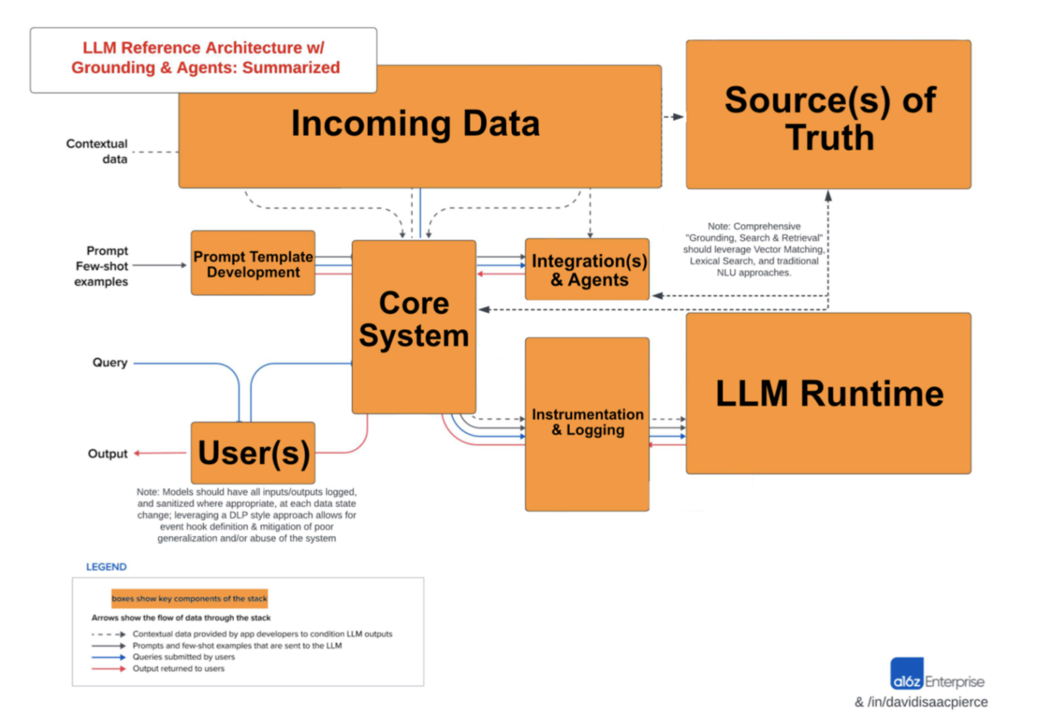

Core Concepts & Key Components
Concepts
Real-Time, Batch, & AI-Driven Orchestration
Downstream Pipelines & Agents
Contextual Grounding & Guardrails
Components
Pre-Processing & Enrichment
Abstraction & Input Sanitization
Monitoring, Validation & Output Sanitization
Notes:
4.1 So how do we start to think about these systems? Initially with data pipelines and your source of truth
click
4.2 Then you can start to think about how you expose your system to users, integrate with other tooling, etc
click
4.3 Finally you can plan for how you abstract your runtime while logging your inputs and outputs.
Whether driving real-time decisions, coordinating the efforts of self-directed agents, or making sure to curate an up-to-date source of truth it turns out these systems are capable of some pretty incredible things, especially when you zoom in
click
4.4 That's where the controls come into play.
click
4.5 without those key components listed on the bottom left, you mind find that your chatbot or autonomous agent went off track.
click

Slide 11
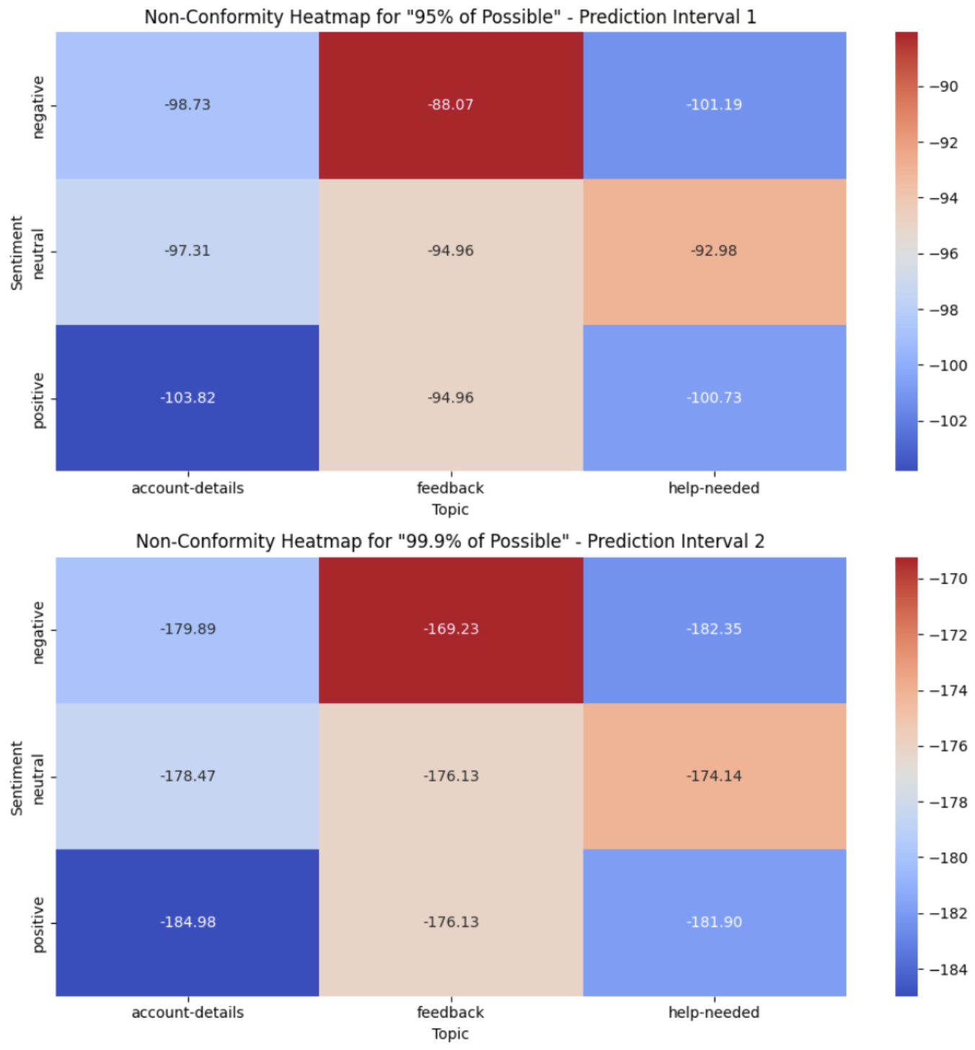
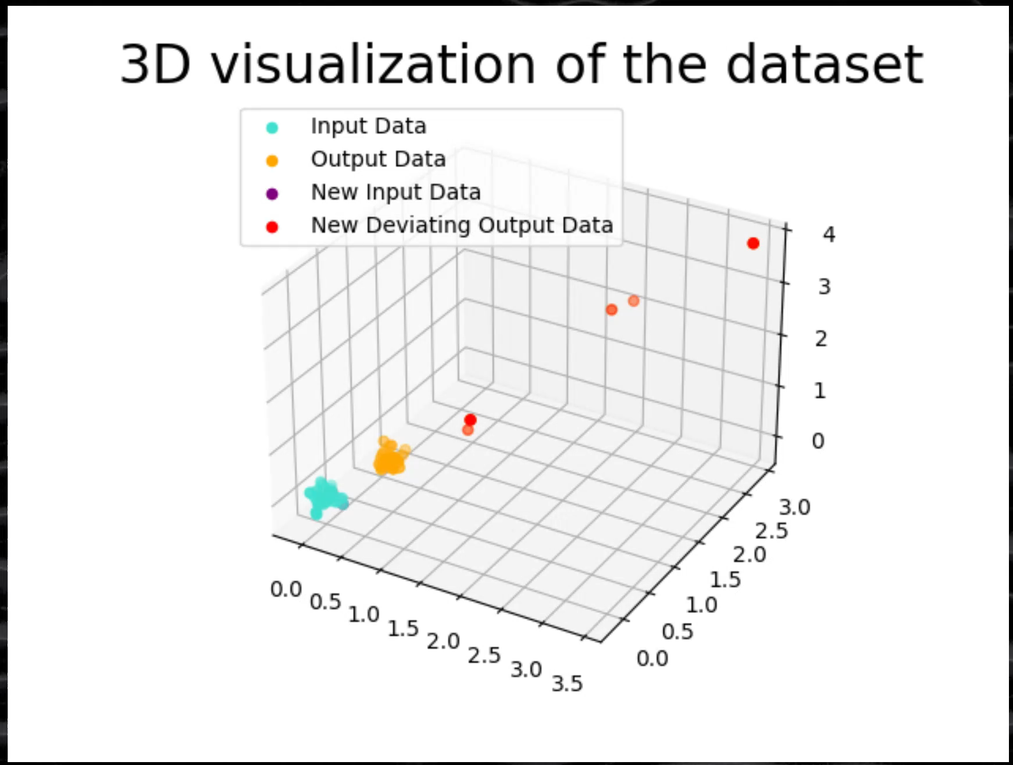
How do you know what your system is doing?
Audit-Drive Architecture
Persist Agentic Planning & Pipelines
Documentation & Discrete Value Decisions
Per-Entity Granularity x IAM Policies
Non-Deterministic Systems & Next-Gen Statistics
Inputs don’t predict Outputs; adjust your priors
Managing Data as State; Event-Driven Metadata
Measure Non-Conformity; Allow for Evolving Schemas
Executive Summary Available
Notes:
That sounds hard right? Nope. LLMs (at least for now) are bad at planning out their day, and we just need to watch what they’re doing. Video
This helps explain the concept in play, but the key really is just making sure models don’t wander into places they’re not built for. Doing that involves 3 things: Better Statistical Methods, Good Data Management Practices, and Evolving Schemas driven by “what good looks like” click Plus you can even use those fancy statistics to forecast behavior

Slide 12
What is Gen AI Hardening?
Active mitigation of vulnerabilities & Exposures
Notes:
Hello my name is David and we're gonna talk about observability, specifically in the context of Securing AI systems

Slide 13
Gen AI Kill List & Defense Plan
Exercise Planning
Definition & Tracking of Team-Specific Goals
Outcomes utilized in AI Risk Framework
Debrief & Update
Leverage SOTA Methods, Podcasts, & Blogs
Frame w/ Existing & Emerging Regulation
Keep Up-to-Date on the Latest Research
Notes:
4.1 So how do we start to think about these systems? Initially with data pipelines and your source of truth
click
4.2 Then you can start to think about how you expose your system to users, integrate with other tooling, etc
click
4.3 Finally you can plan for how you abstract your runtime while logging your inputs and outputs.
Whether driving real-time decisions, coordinating the efforts of self-directed agents, or making sure to curate an up-to-date source of truth it turns out these systems are capable of some pretty incredible things, especially when you zoom in
click
4.4 That's where the controls come into play.
click
4.5 without those key components listed on the bottom left, you mind find that your chatbot or autonomous agent went off track.
click

Slide 14
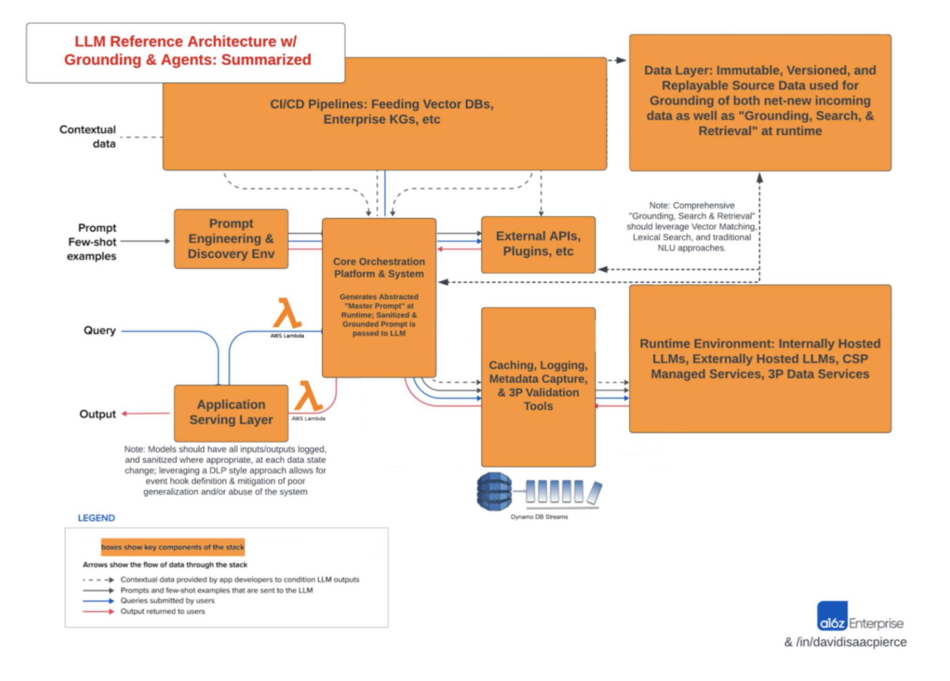

Red + Blue = Purple
Automated Pipelines & Purple Exercises
Open-Source Test Suites for Net-New Models
Industry Standard MITRE Attack Framework
Active Text-Based & Multimodal Attacks
SME-Driven & Cross-Functional
Analytic & Application Teams
Domain-Specific Business Knowledge
Regularly Scheduled & AdHoc
Coordinated Cadence for Participation
AdHoc Exercises for Emerging Threats
Notes:
4.1 So how do we start to think about these systems? Initially with data pipelines and your source of truth
click
4.2 Then you can start to think about how you expose your system to users, integrate with other tooling, etc
click
4.3 Finally you can plan for how you abstract your runtime while logging your inputs and outputs.
Whether driving real-time decisions, coordinating the efforts of self-directed agents, or making sure to curate an up-to-date source of truth it turns out these systems are capable of some pretty incredible things, especially when you zoom in
click
4.4 That's where the controls come into play.
click
4.5 without those key components listed on the bottom left, you mind find that your chatbot or autonomous agent went off track.
click

Slide 15
Isn’t that just observability?
Yes; instrument your systems and solve per-dimension
Notes:
Hello my name is David and we're gonna talk about observability, specifically in the context of Securing AI systems

Slide 16
Observability across verticals
Analytics
Governance
Security
Develop Cross-Modality Support to instrument experience metrics
Identify & Prioritize Needed Data, Model Fine-Tuning, etc
Safely Test Next-Gen Sequence Models (e.g. Mamba, SSMs, etc)
Affect GDPR/CCPA compliant ‘Forgetting & Validation’ via CI/CD Pipelines
Visualize Attestation with GDPR Compliant Layer-Specific Insights into your Models
Build Add’l Detection Services & Sidecars (e.g. BERT, RWKVs, etc)
Monitor Traffic to identify Malware while allowing useful context (e.g. parm’d URLs)
Notes:
That gets us up to now, but we should also be anticipating the problems of tomorrow. click Working Memory Graphs are going to mean that even today’s LLMs can more easily navigate and accomplish their tasks Also federated embedding models make it easy build hidden messages into logs you can see but won’t need words; that’s a human requirement click
Good news is that best practices mitigate those types of threats, and a little bit of planning goes a long way. So curate known good examples of application logs, build a knowledge graph, and carry on.

Slide 17
Q&A
Topics of Interest: Time-Based Blind SQL Injection Hidden Payloads in Binaries Attacking Self-Supervised RL
Notes:
There’s other aspects to Observability beyond security; namely Governance and Performance Monitoring Happy to clarify any of the security stuff, frame the other aspects of observability, else talk about other topics.

Slide 18
Appendix
Add’l Resources & Links

Slide 19
Gen AI System Vulnerabilities Why is this different?
Ubiquitous & In-the-Wild
Universal and Transferable Attacks
Open-Source & Blackbox Frameworks
API, Tool & Function Calling Compounds Risk
Multimodal & Multichannel Susceptibility
Conserved Efficiency of Text (see: figure 3)
Indirect Injection of Attacks
Non-Trivial Hardening

Slide 20
Pre-Processed Attack Example
Summary: Auto-Regressive Sequence Models were built for token prediction; exploiting per-model syntax allows for target-specific instruction (e.g. Overriding System Rules & Alignment)

Slide 21
Gen AI Kill Chain & Defense Plan
Key Exposures & Mitigations

Slide 22
Optimization-Free Attacks
Dependency: Requires specific API fields; no pre-processing
Key Exposure: Brand Reputation Damage & Performance Degradation
Takeaway: Mitigate low-complexity priming attacks via evaluation of input/output embeddings against moving windows of time, as well as limits on what data is available via API (e.g. Next-Token Probabilities aka Logits); also mitigates DDoS attacks and indicates instances of poor generalization

Slide 23
System Context Extraction
Dependency: Requires API Access over time; ‘time-based blind SQL injection’ but for Multimodal Models
Key Exposure: Documentation & Distribution of System Vulnerabilities, Non-Compliance with AI Governance Standards, etc
Takeaway: Mitigate retrieval of information about the system and application controls from Time-Based Blind Injection Attacks via Application-Specific Firewalls and Error Handling Best-Practices; augment detection for sensitive systems by evaluating conformity of inputs/outputs against pre-embedded attack strings, and flagging long-running sessions for review

Slide 24
Model Context Extraction
Dependency: API Access for context window; Access to Embeddings for Decoding (e.g. VectorDB)
Key Exposure: Documentation & Distribution of Model Vulnerabilities & Data Access
Takeaway: Reduce the risk from discoverable rules, extractable context (e.g. persistent attached document-based systems context), etc via pre-defined rules; prevent decodable embeddings (e.g. additional underlying data via VectorDB & Backups) by adding appropriate levels of noise or using customized embedding models for sensitive data.

Slide 25
Pre-Processed Attacks
Dependency: Whitebox Attacks require a localized target; multiple frameworks (e.g. SGA, VLAttack, etc) support Transferable Multimodal Blackbox Attacks
Key Exposure: Data Loss via Exploitation of Distributed Systems
Takeaway: Defeat pre-processed optimization attacks by pre-defining ‘good’ and ‘bad’ behaviors alongside logging, clustering, and flagging of non-conforming inputs/outputs; while utilizing windowed application-specific baselines

Slide 26
Training Data Extraction
Dependency: Requires API Access over time; ‘rules’ defeated via prior system and model context extraction paired with optimized attacks
Key Exposure: Legal Liability from Data Licensure Breaches, Non-Compliance with AI Governance Standards, etc
Takeaway: Prevent disclosure of underlying data while mitigating membership or attribute inference attacks with pre-defined context rules (e.g. “no repetition”), whitelisting & monitoring of allowed topics, as well as DLP paired with active statistical monitoring via pre/post-processing of inputs/outputs
i.e. Data Extraction Attacks build upon pre-discovered rules/context and pre-optimized attacks

Slide 27
Model Data Extraction
Dependency: System Access to GPU; net-new threat vector with myriad vulnerable platforms
Key Exposure: Legal Liability from Data Licensure Breaches; Non-Compliance with AI Governance Standards
Takeaway: Multiple Open-Source Attack frameworks are exploiting a previously underlized data exfiltration vector in the form of GPU VRAM, which has traditionally been a shared resource without active monitoring; secure virtualization and segmentation tooling exists for GPUs but mitigate this vulnerability is an active area of research.

Slide 28
Supply Chain & Data Poisoning
Dependency: Target use of compromised data & models; integration of those vulnerabilities with CI/CD systems
Key Exposure: Reputation Damage & Performance Degradation, Non-Compliance with AI Governance Standards, especially “high-risk systems”
Takeaway: Mitigate Supply Chain & Data Poisoning attacks via use of Open-Source Foundation Models and Open-Source Data wherein Data Provenance/Lineage can be established, versions can be hashed, etc; thereafter affect access and version control of fine-tuning data, contextual data (i.e. augmented generation), etc.

Slide 29
Model Specific Vulnerabilities
Dependency: Lack of Active Assessment of Sensitive or External Systems
Key Exposure: Documentation & Distribution of System Vulnerabilities; Brand Reputation Damage & Performance Degradation
Takeaway: Utilize a Defense in Depth approach (e.g. Purple Teaming), especially for Auto Regressive Models, while staying up to date on the latest attack & defense paradigms; utilize open-source resources, contribute to the community, etc.

